Slide 1

Sensor Kit (Kit 1)
ZAS Robotics Training

Slide 2



Sensor Kit - Contents
Sensor Kit Components
Sensor Creative Board

Slide 3



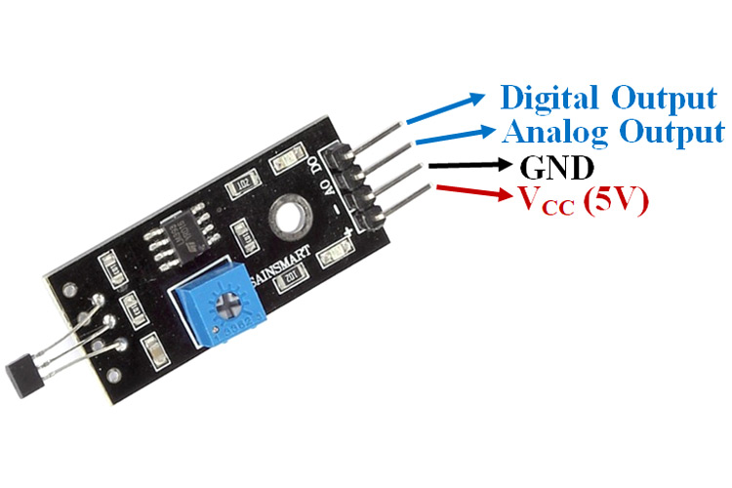

SFL15: HALL SENSOR (FREE CONNECTOR)
Things Needed

Slide 4
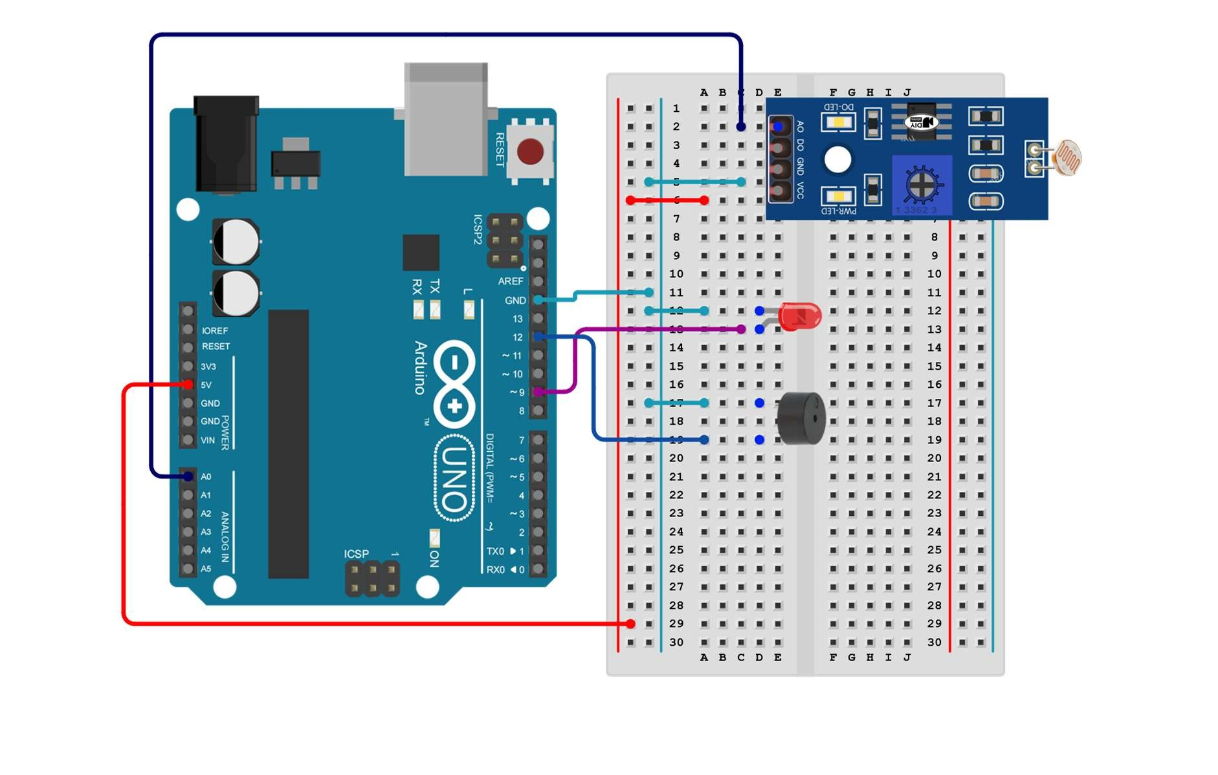
SFL15: HALL SENSOR (FREE CONNECTOR)
Arduino pins | Breadboard
VCC | 5V(red line)
GND | GND(light blue)
A0 | A0(dark blue)

Slide 5
SFL15: HALL SENSOR (FREE CONNECTOR)
Setup()
Connect one terminal of the LDR to the 5V pin on the microcontroller. o Connect the other terminal of the LDR to an analog input pin on the microcontroller (e.g., A0). o Connect a 10kΩ resistor from the analog input pin (A0) to the ground (GND) of the microcontroller. This creates a voltage divider circuit.
Loop()
control the LED and buzzer based on the light level detected by the LDR.
Code for Lesson15:
https://github.com/info-zas/zas-robotics-sensors/blob/main/01_FoundationProjects/01_Code/_08_UsingLDRtoDetectLightAndTriggerAlerts/_08_UsingLDRtoDetectLightAndTriggerAlerts.ino

Slide 6
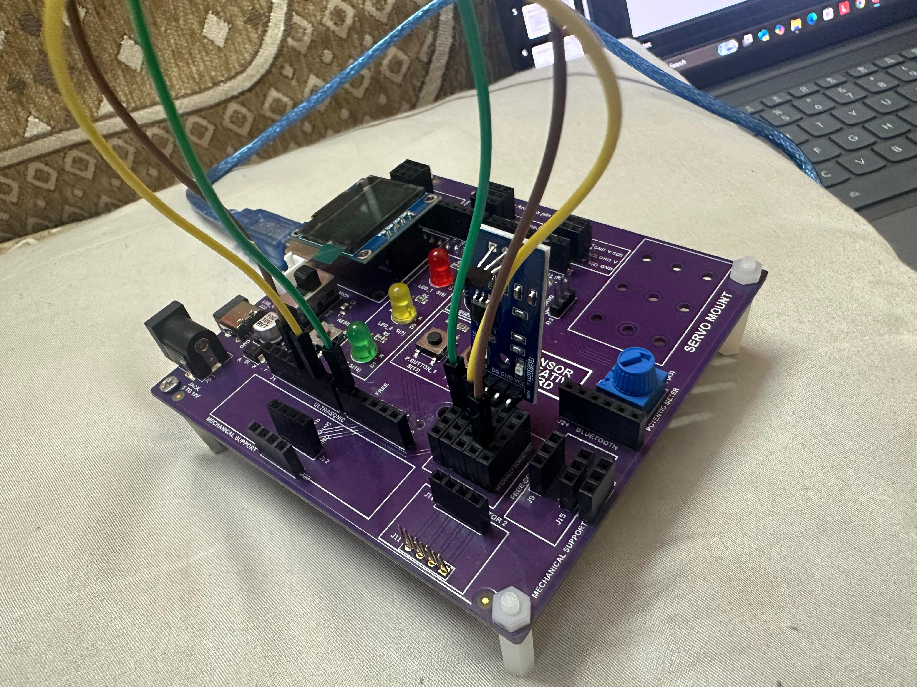
SFL15: HALL SENSOR (FREE CONNECTOR)

Slide 7
SFL15: HALL SENSOR (FREE CONNECTOR)

